Slide 1
Deep Neural Network
Notes:
linear, quadratic, trigonometric

Slide 2
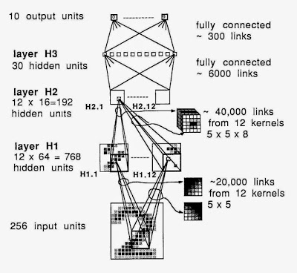
Deep Learning (Data-Driven Machines)
Learning from examples and today's state-of-the-art recognition techniques
Deep Learning emphasizes the network architecture of today's most successful machine learning approaches.
A Deep Network from 1989
Notes:
I'd like to emphasize that using deep architectures (as of 2015) is not new. But what is new?

Slide 3
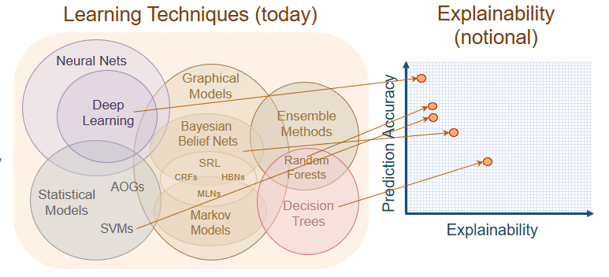




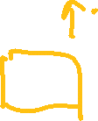

Deep Learning vs. Other Method

Slide 4

Deep Learning Revolution
Is deep learning a revolution in artificial intelligence?
Apple’s Siri virtual personal assistant
Google’s Street View & Self-Driving Car
Google/Facebook/Tweeter/Yahoo
Google’s DeepMind AlphaGO

Slide 5


Deep Neural Network
‘Deep Learning’ means using a neural network with several layers of nodes between input and output
Why is it generally better than other methods on image, speech and certain other types of data?
the series of layers between input & output do feature identification and processing in a series of stages, just as our brains seem to.
Multilayer neural networks have been around for 35 years. What’s actually new?
We have always had good algorithms for learning the weights in networks with 1 hidden layer. But these algorithms are not good at learning the weights for networks with more hidden layers
What’s new is: algorithms for training many-layer networks

Slide 6
Training a Deep Network
Weights are learned layer by layer via unsupervised learning.
Final layer is learned as a supervised neural network.
All weights are fine-tuned using supervised back propagation.

Slide 7
Deep Learning
Deep Neural Network Model
Activation Functions
Hyperparameter
Training Deep Neural Network
Data preprocessing
Initial weights
Optimization solvers
Practical Techniques

Slide 8
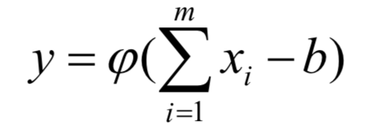

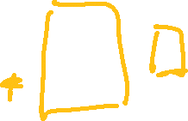
Activation Functions

Slide 9
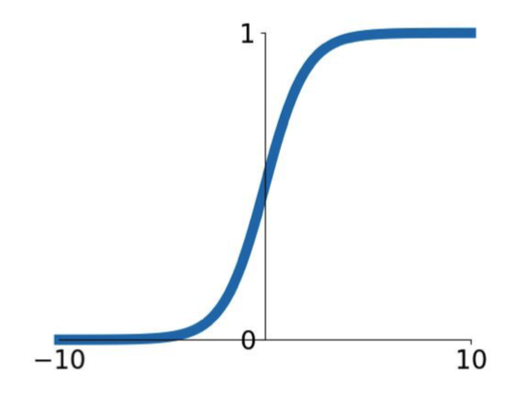
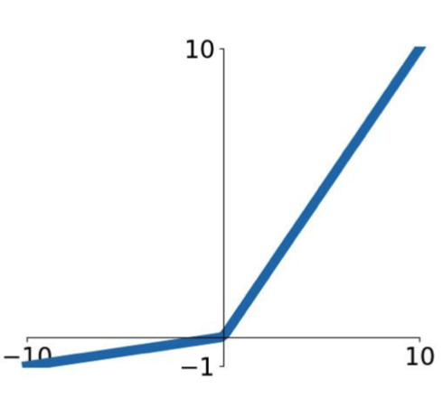
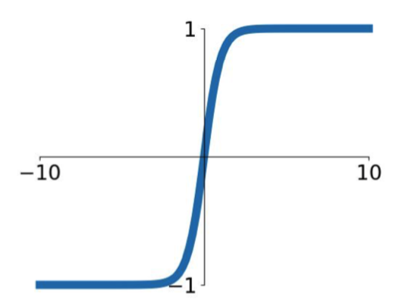
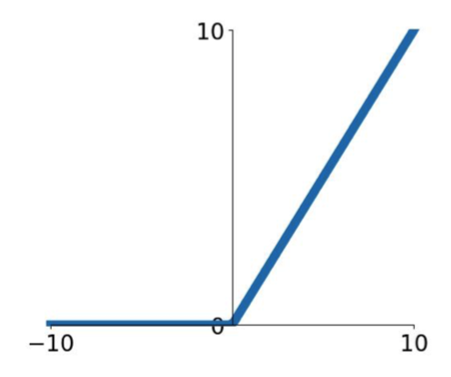
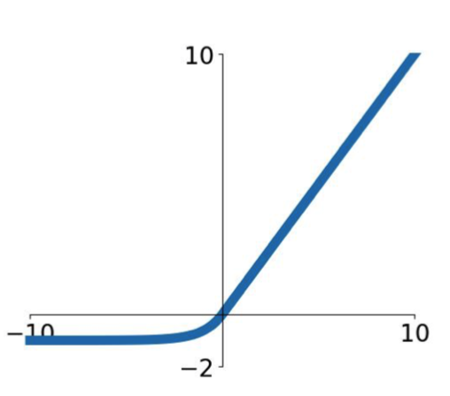
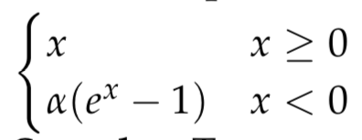
How to Choose Activation Functions?
Sigmoid
Tanh
ReLU
Leaky ReLU
Maxout
ELU - Exponential Linear Unit

Slide 10





Sigmoid
Sigmoid takes a real-valued number and “squashes” it into range between 0 and 1.
Nice interpretation of the firing mechanism of a neuron
Not commonly used
Sigmoid saturates and kill gradients
Sigmoid outputs are not zero-centered
exp() computation expensive
Notes:
Sigmoids saturate and kill gradients. A very undesirable property of the sigmoid neuron is that when the neuron's activation saturates at either tail of 0 or 1, the gradient at these regions is almost zero. Recall that during back-propagation, this (local) gradient will be multiplied to the gradient of this gate's output for the whole objective. Therefore, if the local gradient is very small, it will effectively “kill” the gradient and almost no signal will flow through the neuron to its weights and recursively to its data. Additionally, one must pay extra caution when initializing the weights of sigmoid neurons to prevent saturation. For example, if the initial weights are too large then most neurons would become saturated and the network will barely learn.
Sigmoid outputs are not zero-centered. This is undesirable since neurons in later layers of processing in a Neural Network (more on this soon) would be receiving data that is not zero-centered. This has implications on the dynamics during gradient descent, because if the data coming into a neuron is always positive (e.g., element wise in ), then the gradient on the weights will during back-propagation become either all be positive, or all negative (depending on the gradient of the whole expression ). This could introduce undesirable zig-zagging dynamics in the gradient updates for the weights. However, notice that once these gradients are added up across a batch of data the final update for the weights can have variable signs, somewhat mitigating this issue. Therefore, this is an inconvenience but it has less severe consequences compared to the saturated activation problem above.

Slide 11

Tanh
tanh(x) squashes a real-valued number to the range [-1, 1] Nice interpretation of the firing mechanism of a neuron
tanh(x) saturate and kill gradients
The outputs of tanh(x) are zero-centered
tanh non-linearity is always preferred to the sigmoid nonlinearity
Notes:
Sigmoids saturate and kill gradients. A very undesirable property of the sigmoid neuron is that when the neuron's activation saturates at either tail of 0 or 1, the gradient at these regions is almost zero. Recall that during back-propagation, this (local) gradient will be multiplied to the gradient of this gate's output for the whole objective. Therefore, if the local gradient is very small, it will effectively “kill” the gradient and almost no signal will flow through the neuron to its weights and recursively to its data. Additionally, one must pay extra caution when initializing the weights of sigmoid neurons to prevent saturation. For example, if the initial weights are too large then most neurons would become saturated and the network will barely learn.
Sigmoid outputs are not zero-centered. This is undesirable since neurons in later layers of processing in a Neural Network (more on this soon) would be receiving data that is not zero-centered. This has implications on the dynamics during gradient descent, because if the data coming into a neuron is always positive (e.g., element wise in ), then the gradient on the weights will during back-propagation become either all be positive, or all negative (depending on the gradient of the whole expression ). This could introduce undesirable zig-zagging dynamics in the gradient updates for the weights. However, notice that once these gradients are added up across a batch of data the final update for the weights can have variable signs, somewhat mitigating this issue. Therefore, this is an inconvenience but it has less severe consequences compared to the saturated activation problem above.

Slide 12
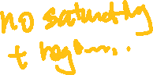

Rectified Linear Unit (ReLU)
Rectified Linear Unit (ReLU) computes max(0,x) which is simply threshold at zero
ReLU has become very popular in the last few years.
Pros
Easy to implement and computation efficient
Without saturating in +region
Greatly accelerate the convergence of stochastic gradient descent (much faster than sigmoid/tanh)
Cons
Not zero-centered output
ReLU units can be fragile during training and can “die”

Slide 13




Leaky ReLU
Does not saturate
Computationally efficient
Converges much faster than sigmoid/tanh in practice!
Will not “die”

Slide 14

Exponential Linear Units (ELU)
All benefits of ReLU
Closer to zero mean outputs
Negative saturation regime
Add some robustness to noise (compared with Leaky ReLU)
Computation requires exp()

Slide 15



Maxout Neuron
Does not have the basic form of dot product: nonlinearity
Generalizes ReLU and Leaky ReLU
Linear regime; does not saturate; does not die
The number of parameters doubles.

Slide 16






General Rules for Activation Functions
Use ReLU. Choose a proper learning rate.
Try out Leaky ReLU / Maxout / ELU
Try out tanh but don’t expect much
Don’t use sigmoid in hidden layers

Slide 17
Hyperparameter Optimization

Slide 18


What Hyperparameters to Optimize?
Network architecture
Learning rate; its decay schedule; update type
Regularization (L2/Dropout strength)

Slide 19
Cross-Validation Strategy (Manual Trials)
Coarse -> fine: cross-validation in stages
First stage: only a few epochs to get rough idea of what parameters work
Second stage: longer running time, finer search
Going on as needed
Tip for detecting explosions in the solver: If the cost is ever > 3 * original cost, break out early
Best to optimize in log space (to the power of 10)

Slide 20
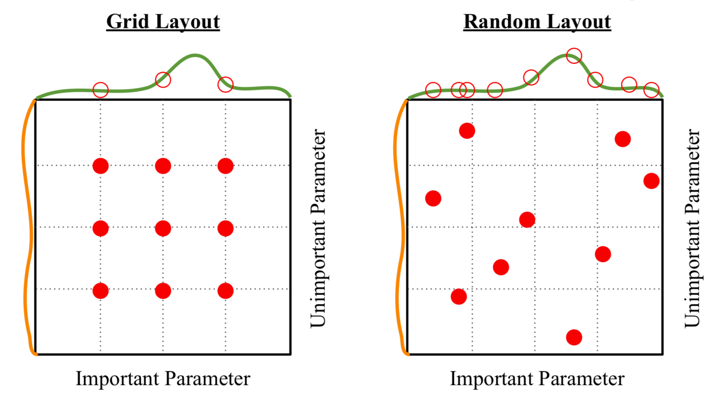

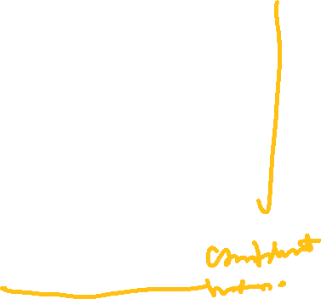


Random Search vs. Grid Search

Slide 21
Data Preprocessing

Slide 22
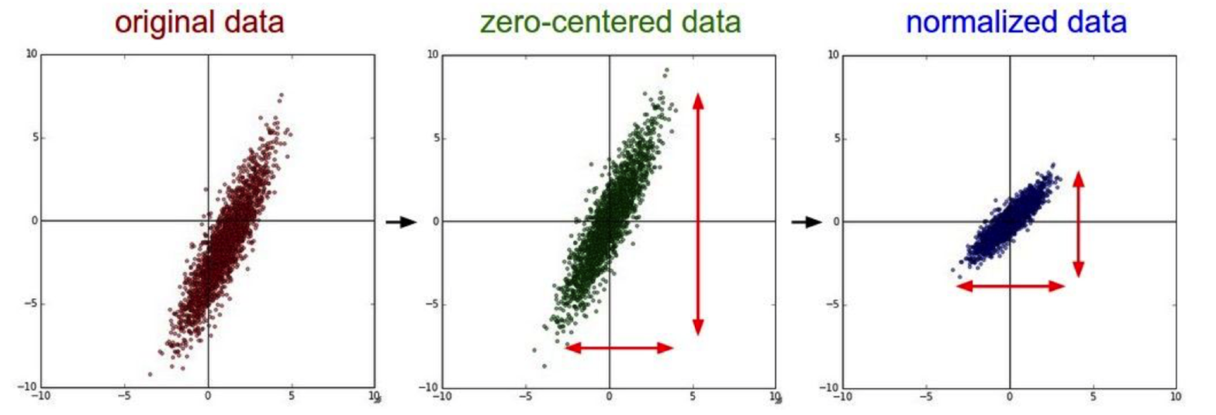


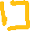
Data Preprocessing: Recommended
Data preprocessing is a must!
Zero-center: put the mean at zero. Why?
Normalize: assume data follow normal distribution

Slide 23
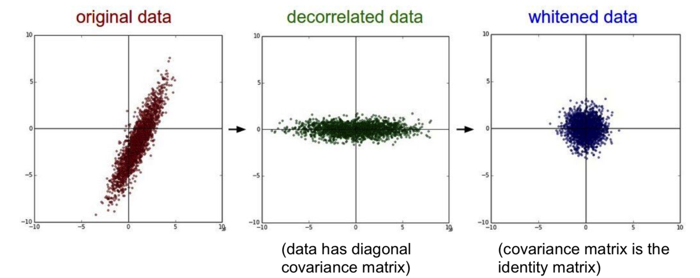
Data Preprocessing: Optional
Decorrelate: project the original zero-centered data into the eigenbasis
Whitening: takes the data in the eigenbasis and divides every dimension by the eigenvalue to normalize the scale

Slide 24

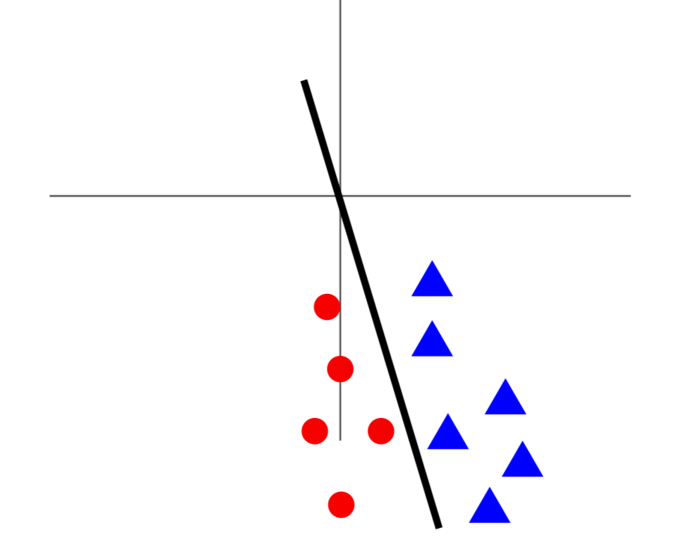
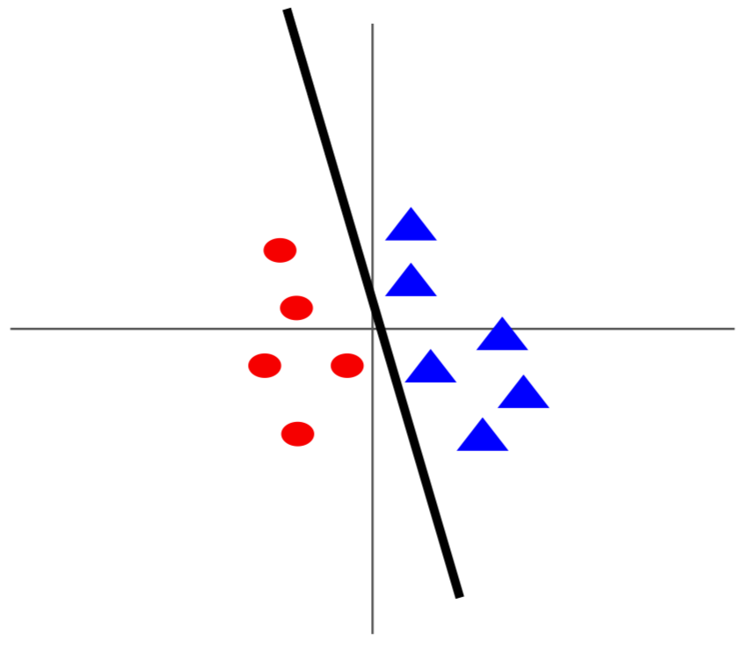
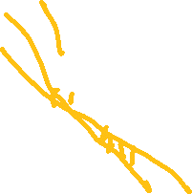

Why Data Normalization?
Before normalization: classification loss very sensitive to changes in weight matrix; hard to optimize
After normalization: less sensitive to small changes in weights; easier to optimize

Slide 25
Recap: Training a Deep Network
Weights are learned layer by layer via unsupervised learning.
Final layer is learned as a supervised neural network.
All weights are fine-tuned using supervised back propagation.

Slide 26
Recap: Deep Learning Challenges
Deep Neural Network Model
Activation Functions
Hyperparameter
Training Deep Neural Network
Data preprocessing
Initial weights
Optimization solvers
Practical Techniques

Slide 27
Recall General Rules for Activation Functions
Use ReLU. Choose a proper learning rate.
Try out Leaky ReLU / Maxout / ELU
Try out tanh but don’t expect much
Don’t use sigmoid in hidden layers

Slide 28
Recap Activation Function
Sigmoid
Tanh
ReLU
Leaky ReLU
Maxout
ELU - Exponential Linear Unit

Slide 29
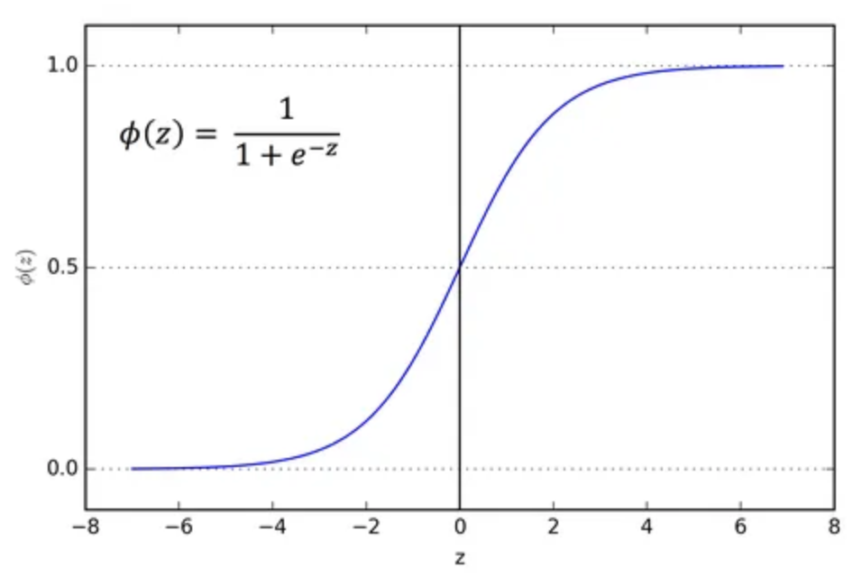
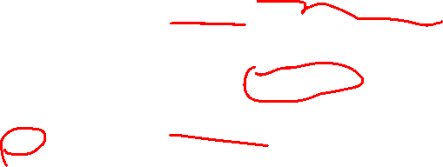
Recap Sigmoid
[0,1] good for modeling probability
Sigmoid saturates and kill gradients
Sigmoid outputs are not zero-centered
exp() computation expensive

Slide 30
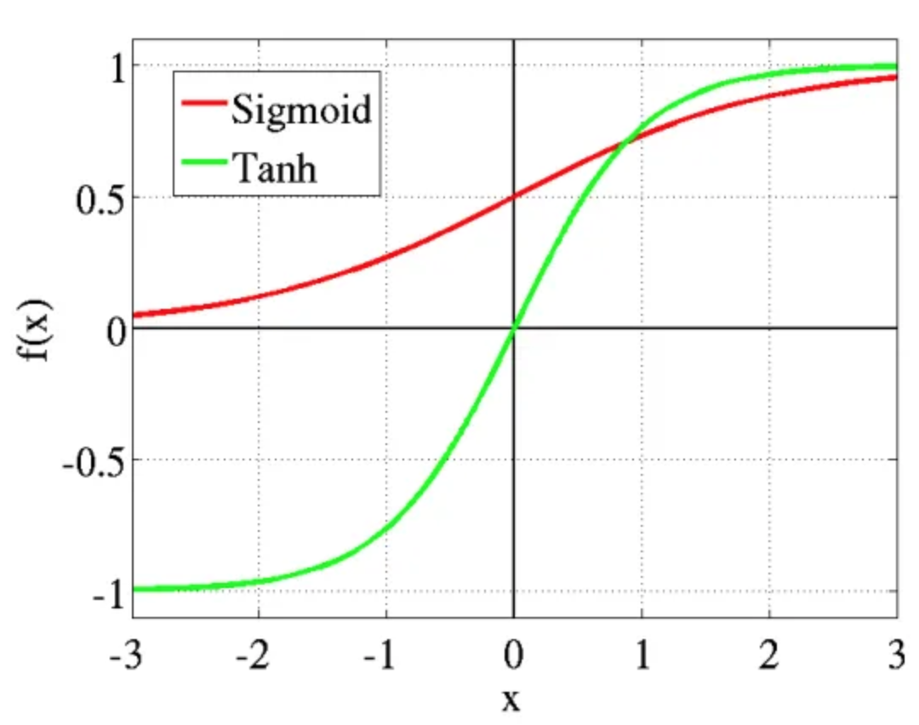
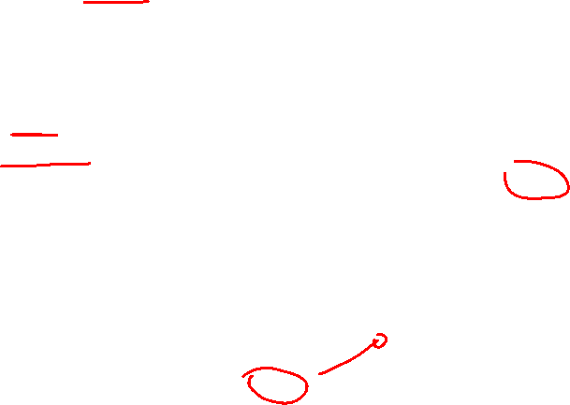
Recap Tanh
Range [-1, 1], good for classification problems.
The outputs of tanh(x) are zero-centered.
Tanh non-linearity is always preferred to the sigmoid nonlinearity
Tanh(x) saturate and kill gradients

Slide 31
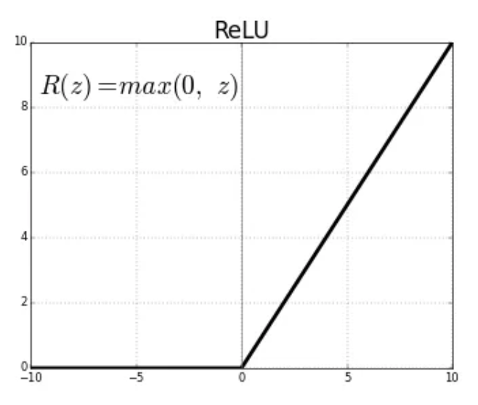
Recall ReLU
The most used activation function
Easy to implement and computation efficient
Without saturating in +region
Greatly accelerate the convergence of stochastic gradient descent (much faster than sigmoid/tanh)
Negative values below 0
Die ReLU problem:
A "dead" ReLU always outputs the same value (zero as it happens, but that is not important) for any input.

Slide 32
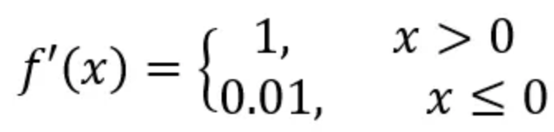
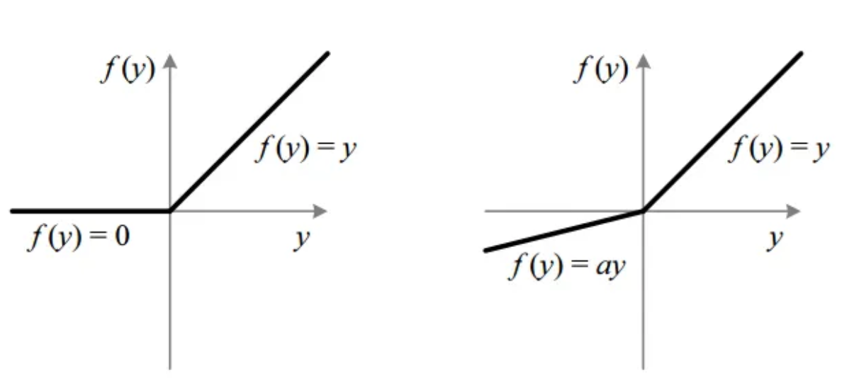
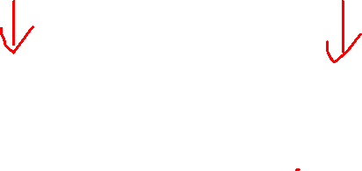
Recall Leaky ReLU
Does not saturate
Computationally efficient
Converges much faster than sigmoid/tanh in practice!
Will not “die”
Sensitive to noise

Slide 33
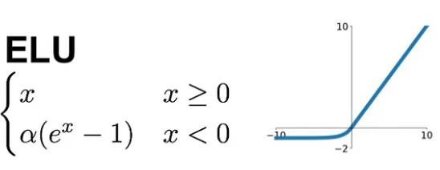
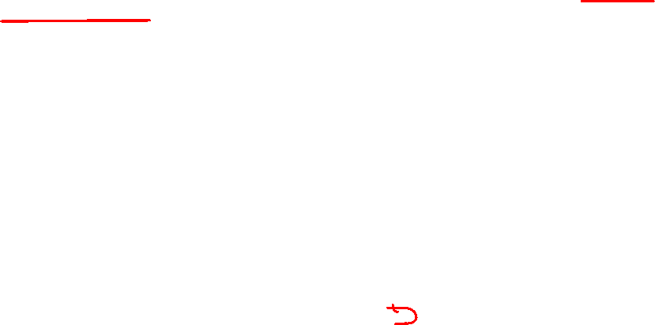
Recall Exponential Linear Unit (ELU)
All benefits of ReLU
Closer to zero mean outputs (Faster convergence)
Add some robustness to noise (compared with Leaky ReLU)
Negative saturation regime
Computation requires exp()

Slide 34
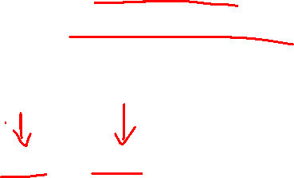
Recall Maxout Neurons
Does not have the basic form of dot product: nonlinearity
Generalizes ReLU and Leaky ReLU
Linear regime; does not saturate; does not die
Computationally expensive as it doubles the number of
Parameters for each neuron.

Slide 35
Recap What Hyperparameters to Optimize?
Network architecture
Learning rate; its decay schedule; update type
Regularization (L2/Dropout strength)

Slide 36
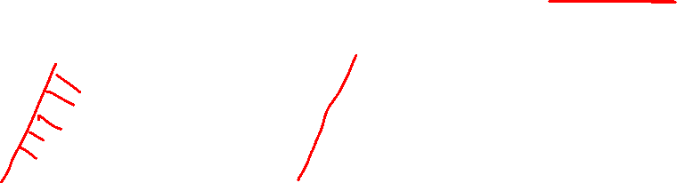
Recap Data Preprocessing: Recommended
Data preprocessing is a must!
Zero-center: put the mean at zero. Why?
Normalize: assume data follow normal distribution

Slide 37
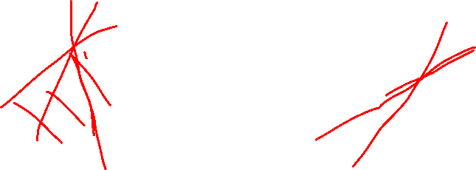
Recap Why Data Normalization?
Before normalization: classification loss very sensitive to changes in weight matrix; hard to optimize
After normalization: less sensitive to small changes in weights; easier to optimize

Slide 38
Initial Weights

Slide 39
How to Initialize the Weights?
All zero Initialization
Initialization with small random numbers
Calibrating the variances: normalize the variance of each neuron's output to 1
Latest (best?): the variance of neurons in the network should be 2.0/n where n is the number of weights

Slide 40





Recap: Deep Learning vs. Other Method

Slide 41
Recap: Training a Deep Network
Weights are learned layer by layer via unsupervised learning. Final layer is learned as a supervised neural network.
All weights are fine-tuned using supervised back propagation.
Forward Propagation
Backward Propagation

Slide 42
Recap: Deep Learning
Deep Neural Network Model
Activation Functions
Hyperparameter
Training Deep Neural Network
Data preprocessing
Initial weights
Optimization solvers
Practical Techniques

Slide 43
Recap Activation Function
Sigmoid
Tanh
ReLU
Leaky ReLU
Maxout
ELU - Exponential Linear Unit
Normally take longer training time,
due to double parameters.

Slide 44
Recap Activation Function
Sigmoid
Tanh
ReLU
Leaky ReLU
Maxout
ELU - Exponential Linear Unit
[0,1] good for modeling probability
Usually used in the last layer (output layer)
Sigmoid saturates and kill gradients
Sigmoid outputs are not zero-centered
exp() computation expensive

Slide 45
Recap Activation Function
Sigmoid
Tanh
ReLU
Leaky ReLU
Maxout
ELU - Exponential Linear Unit
Range [-1, 1], good for classification problems.
Usually used in the last layer (output layer)
Tanh(x) saturate and kill gradients

Slide 46
Recap Activation Function
Sigmoid
Tanh
ReLU
Leaky ReLU
Maxout
ELU - Exponential Linear Unit
The most used activation function
Easy to implement and computation efficient
Without saturating in +region
Greatly accelerate the convergence of stochastic gradient descent (much faster than sigmoid/tanh)
Negative values below 0
Die ReLU problem:
A "dead" ReLU always outputs the same value (zero as it happens, but that is not important) for any input.
Try Leaky ReLU or ELU

Slide 47
Recall General Rules for Activation Functions
Use ReLU. Choose a proper learning rate.
Try out Leaky ReLU / Maxout / ELU
Try out tanh but don’t expect much
Don’t use sigmoid in hidden layers

Slide 48
Recap: Hyperparameters to Optimize?
Network architecture
Learning rate; its decay schedule; update type
Regularization (L2/Dropout strength)

Slide 49
Data Preprocessing: Recommended
Data preprocessing is a must!
Zero-center: put the mean at zero. Why?
Normalize: assume data follow normal distribution

Slide 50



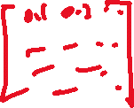




Recap: How to Initialize the Weights?
All zero Initialization
Initialization with small random numbers
Calibrating the variances: normalize the variance of each neuron's output to 1
Latest (best?): the variance of neurons in the network should be 2.0/n where n is the number of weights

Slide 51
Optimization Solver

Slide 52
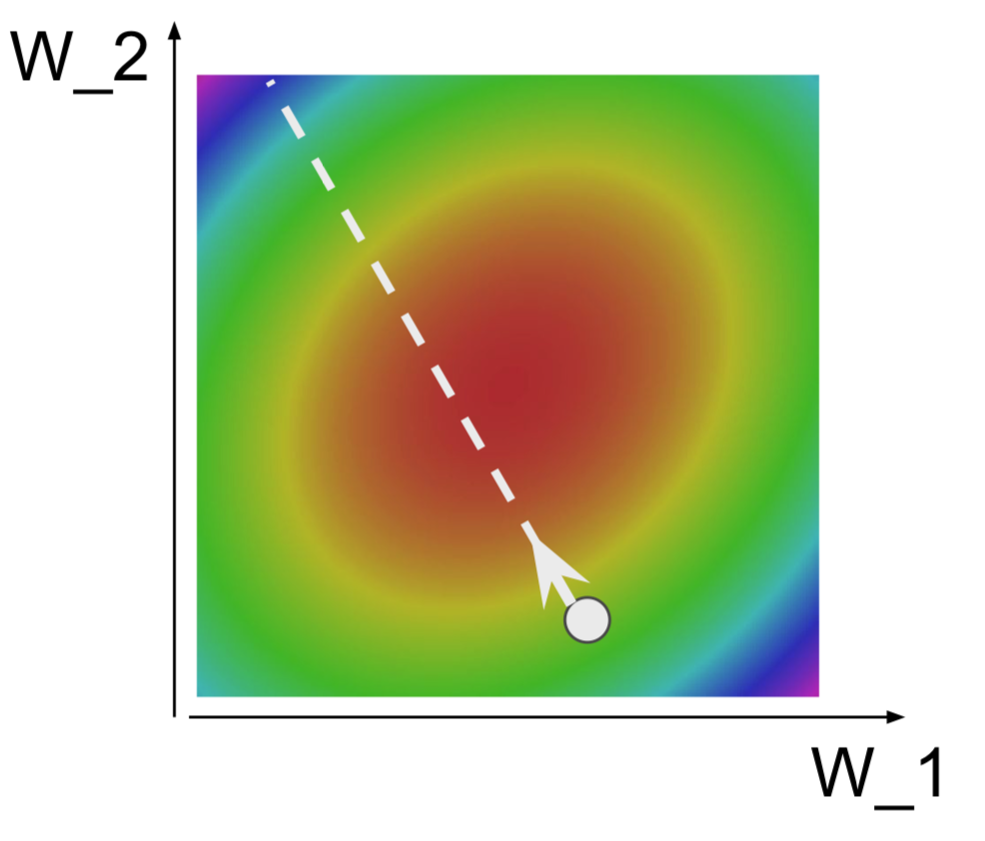



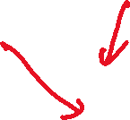






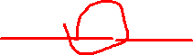





Gradient Descent Optimization Algorithms
Initialize weights w
Repeat
For each data point x, do the following:
Forward propagation: compute outputs and activations
Backward propagation: compute errors for each output units and hidden units. Compute gradient for each weight.
Update weight w *= w - η (∂E / ∂w)
Until a number of iterations or errors drops below a threshold.
Minima
Error
W
Notes:
First order methods

Slide 53
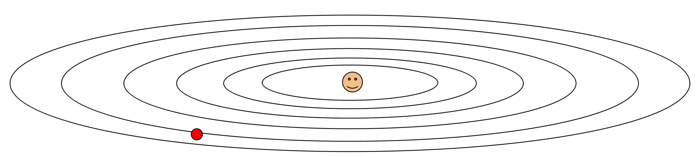
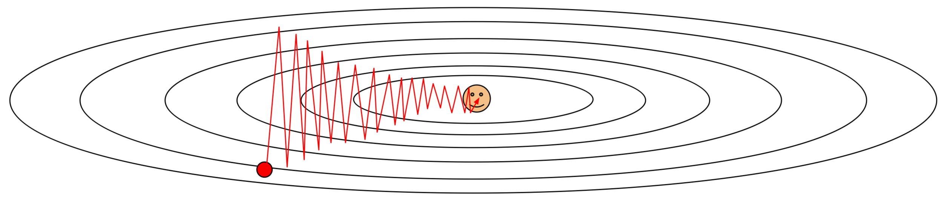
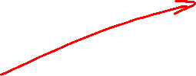
Problems with Gradient Descent
What if loss changes quickly in one direction and slowly in another? What does gradient descent do?
Very slow progress along shallow dimension, jitter along steep direction
Loss function has high condition number: ratio of largest to smallest singular value of the Hessian matrix is large

Slide 54

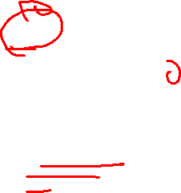
Problems with Gradient Descent
What if the loss function has a local minima or saddle point?
Saddle points much more common in high dimension
Zero gradient
gradient descent gets stuck

Slide 55
Challenges
Choosing a proper learning rate can be difficult.
A learning rate that is too small leads to painfully slow convergence
A learning rate that is too large can hinder convergence and cause the loss function to fluctuate around the minimum or even to diverge.
Learning rate schedules try to adjust the learning rate during training, but it has to be determined before the training.
The same learning rate applies to all parameter updates, but some parameters are more sensitive.
Another key challenge of minimizing highly non-convex error functions common for neural networks is avoiding getting trapped in their numerous suboptimal local minima.

Slide 56
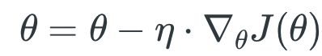


Batch Gradient Descent
Batch gradient descent, aka Vanilla gradient descent, computes the gradient of the cost function w.r.t. to the parameters for the entire training dataset
As we need to calculate the gradients for the whole dataset to perform just one update, batch gradient descent can be very slow and is intractable for datasets that don't fit in memory.
Batch gradient descent also doesn't allow us to update our model online.

Slide 57
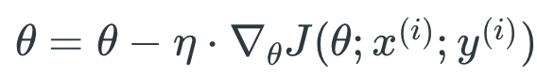

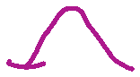


Stochastic Gradient Descent
Stochastic gradient descent (SGD) in contrast performs a parameter update for each training example
Batch gradient descent performs redundant computations for large datasets, as it recomputes gradients for similar examples before each parameter update.
SGD does away with this redundancy by performing one update at a time. It is therefore usually much faster and can also be used to learn online.

Slide 58
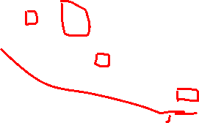
Stochastic Gradient Descent
SGD performs frequent updates with a high variance that cause the objective function to fluctuate heavily.
+ SGD's fluctuation, on the one hand, enables it to jump to new and potentially better local minima.
- this ultimately complicates convergence to the exact minimum, as SGD will keep overshooting

Slide 59
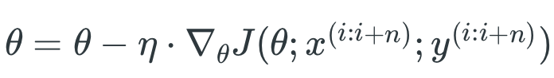


Mini-Batch Gradient Descent
Mini-batch gradient descent finally takes the best of both worlds and performs an update for every mini-batch of n training examples
+ Reduces the variance of the parameter updates, which can lead to more stable convergence
+ can make use of highly optimized matrix optimizations common to state-of-the-art deep learning libraries
Common mini-batch sizes range between 50 and 256, but can vary for different applications

Slide 60
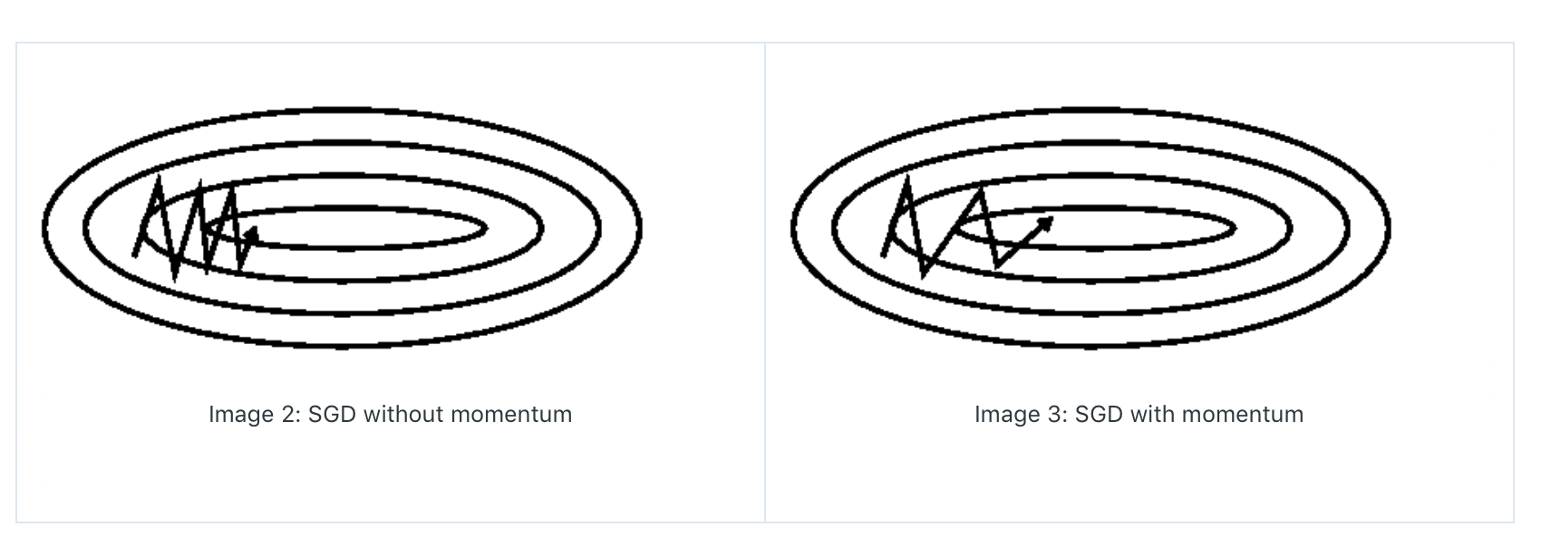
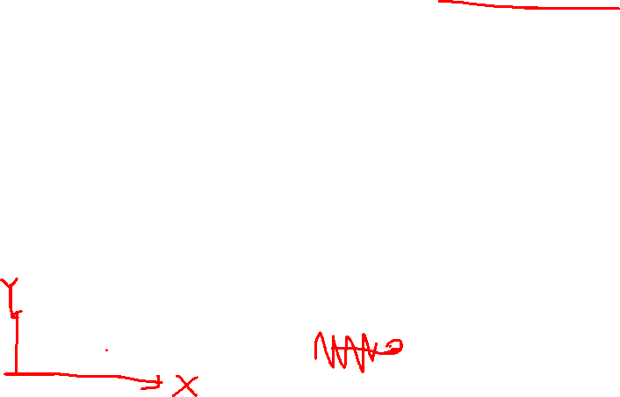
Stochastic Gradient Decent + Momentum
SGD has trouble navigating ravines, i.e. areas where the surface curves much more steeply in one dimension than in another, which are common around local optima.
Momentum is a method that helps accelerate SGD in the relevant direction and dampens oscillations.

Slide 61
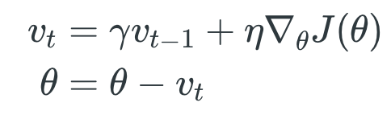





SGD+ Momentum
It does this by adding a fraction of the update vector of the past time step to the current update vector.
Some implementations exchange the signs in the equations. The momentum term is usually set to 0.9 or a similar value.

Slide 62









Nesterov Accelerated Gradient (NAG)
Nesterov accelerated gradient (NAG): use an approximation of the next position of the parameters (the gradient is missing for the full update), a rough idea where our parameters are going to be.
Notes:
A ball that rolls down a hill, blindly following the slope, is highly unsatisfactory.
A smarter ball that has a notion of where it is going so that it knows to slow down before the hill slopes up again.

Slide 63













Adagrad
It adapts the learning rate to the parameters, performing smaller updates for parameters associated with frequently occurring features, and larger updates for parameters associated with infrequent features.
It is well-suited for dealing with sparse data. where G_{t} is a diagonal matrix where each diagonal element is the sum of the squares of the gradients w.r.t.
Notes:
(i.e. low learning rates) (i.e. high learning rates)
Added element-wise scaling of the gradient based on the historical sum of squares in each dimension
“Per-parameter learning rates” or “adaptive learning rates”
Progress along “steep” directions is damped; progress along “flat” directions is accelerated

Slide 64


RMSprop (Root Mean Squared Propagation)
RMSprop as well divides the learning rate by an exponentially decaying average of squared gradients

Slide 65





Adaptive Moment Estimation (Adam)
The decaying averages of past and past squared gradients where m_{t} and v_{t} are estimates of the first moment (the mean) and the second moment (the uncentered variance) of the gradients respectively
Bias-corrected first and second moment, and update

Slide 66


Visualization of Algorithms
contours of a loss surface
a saddle point
Adadelta is a more robust extension of Adagrad that adapts learning rates based on a moving window of gradient updates, instead of accumulating all past gradients.
Notes:
As we can see, the adaptive learning-rate methods, i.e. Adagrad, Adadelta, RMSprop, and Adam are most suitable and provide the best convergence for these scenarios.

Slide 67
What Optimizer to Use?
If your input data is sparse, then you likely achieve the best results using one of the adaptive learning-rate methods (no need to tune learning rates).
Insofar, RMSprop, Adadelta, and Adam are very similar algorithms that do well in similar circumstances. Adam might be the best overall choice.
If you care about fast convergence and train a deep or complex neural network, you should choose one of the adaptive learning rate methods.
Sparse?

Slide 68
Practical Issues

Slide 69
What Does the Training Process Tell Us?
Learning rate
Notes:
e.g. decay learning rate by half every few epochs.

Slide 70
What Does the Training Process Tell Us?
Loss

Slide 71
What Does the Training Process Tell Us?
Accuracy curve

Slide 72

Reduce the Error on New Data
Stop training the model when accuracy on the validation set decreases
Or train for a long time, but always keep track of the model snapshot that worked best on validation

Slide 73
Model Ensembles
Train multiple independent models
At test time average their results (average of predicted probability distributions then argmax)
Usually 2% extra performance
Instead of training independent models, use multiple snapshots of a single model during training.
Instead of using actual parameter vector, keep a moving average of the parameter vector and use that as test time.

Slide 74
How to Avoid Overfitting?
Regularization
L2 regularization
L1 regularization
Max norm
Dropout
During training, dropout samples a Neural Network within the full Neural Network, and only updates the parameters of the sampled network based on the input data.
During testing there is no dropout applied
Extremely effective, simple; use it!
Max Pooling
Take the local maximum to represent all

Slide 75

Regularization - Dropout
Dropout: In each forward pass, randomly set some neurons to zero Probability of dropping is a hyperparameter; 0.5 is common

Slide 76

Why Dropout Works?
Forces the network to have a redundant representation
Prevents co-adaptation of features
Notes:
Dropout is training a large ensemble of models (that share parameters).

Slide 77
Dropout at Test Time
At test time all neurons are active always
We must scale the activations so that for each neuron: output at test time = expected output at training time
Drop in training -> scale at test time
Drop in training and scaled -> test time is unchanged

Slide 78

Max-Pooling
Max pooling is a sample-based discretization process.
The objective is to down-sample an input representation (image, hidden-layer output matrix, etc.), reducing its dimensionality and allowing for assumptions to be made about features contained in the sub-regions binned.

Slide 79
What if We Don‘t Have Many Data?
Image data augmentation
Flipping, crop, and rotation
Combination: translation, rotation, stretching, shearing, lens distortions
Color alternation
Other data?

Slide 80
Training Accuracy Decreases
Reduce your learning rate to a very small number like 0.001 or even 0.0001.
Provide more data.
Set Dropout rates to a number like 0.2. Keep them uniform across the network.
Try decreasing the batch size.
Using appropriate optimizer: You may need to experiment a bit on this. Use different optimizers on the same network, and select an optimizer which gives you the least loss.
Accuracy curve

Slide 81
Summary
Deep neural network model
Model training
Practical issues

